Slide 1
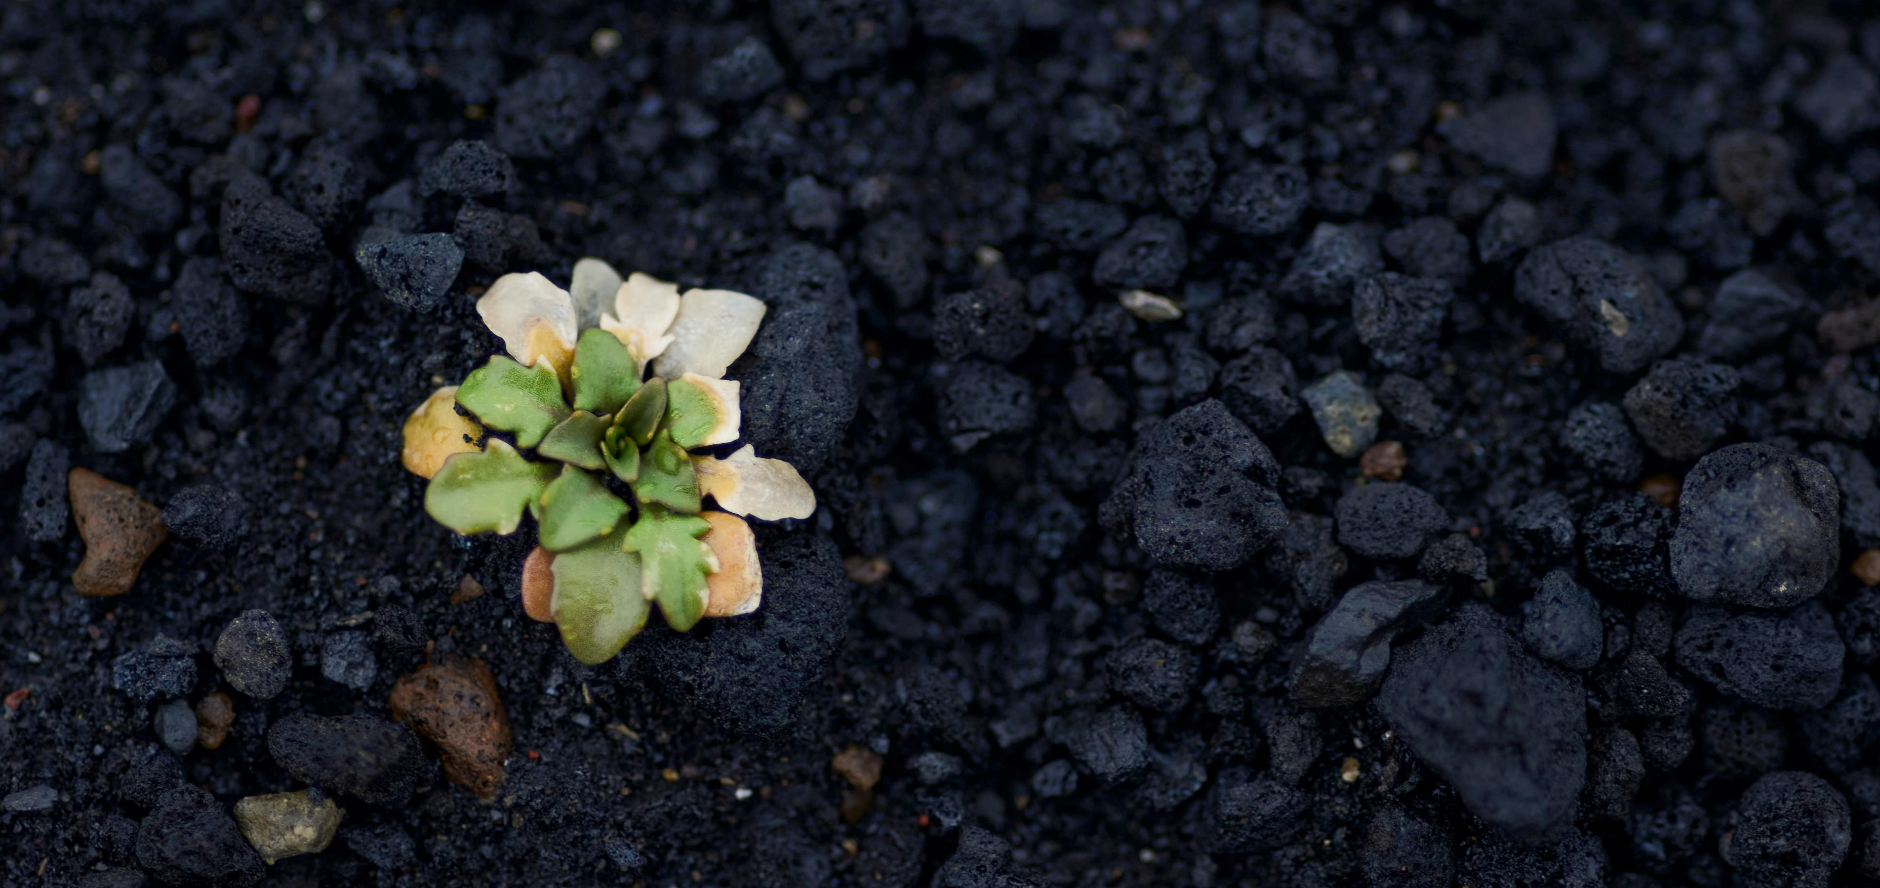
Sortirovka - NVM
Tseny | Kr/tonny
Goryuchiye | 658
Drevesina | 104
Osobyy (minerskaya sherst') | 901
Metallolom | -1245
Smeshannyy (dlya post-sortirovki) | 906
Zapolnit' material | 165
Gips | 500
Masele minerale | 165
Svalka | 988
Karton | -675
Plastik | 493
Kabel' | -5504
Skanska stremitsya stat' klimaticheski neytral'noy k 2045 godu
Segodnya: otkhody sostavlyayut okolo 5% nashego obshchego vozdeystviya na klimat
Imeya khoroshuyu sortirovku, my ekonomim ne tol'ko na vybrosakh SO2, no i na den'gakh.

Slide 2
Kak sokrashchayutsya vybrosy CO2 pri sortirovke na NVM 2021
Bez sortirovki
Pri sortirovke
Material | Tonnazh | Tonny CO2
Elektronnyy
Drevesina
Goryuchiye
Upakovochnyye materialy
Svalka (sortirovannaya)
Gips
Lom i metall
Zapolnit' material
Smeshannyye otkhody dlya post-sortirovki | 1200 | -624
Opasnyye otkhody
Utilizatsiya CO2 (tonny) | 1200 | -624
Material | Tonnazh | Tonny CO2
Elektronnyy | 2 | 5
Drevesina | 315 | 0
Goryuchiye | 130 | -33
Upakovochnyye materialy | 40 | 23
Svalka (sortirovannaya) | 0 | 0
Gips | 178 | 36
Lom i metall | 166 | 349
Zapolnit' material | 356 | -249
Smeshannyye otkhody dlya post-sortirovki | 13 | -7
Opasnyye otkhody | 0 | 0
Utilizatsiya CO2 (tonny) | 1200 | 123
Vozdeystviye transporta otkhodov | Obshchiy tonnazh | Tonny CO2
 | 1200 | -13
Tonny CO2 |  | -637 tonna
Vozdeystviye transporta otkhodov | Obshchiy tonnazh | Tonny CO2
 | 1200 | -13
Tonny CO2 |  | 110 tonna
Nagruzka na okruzheniye bez sortirovki
Sokhraneno dlya okruzhayushchey sredy putem sortirovki

Slide 3
Udachnoy i zelenoy nedeli!

